Slide 1
Python Libraries for Machine Learning

Slide 2
What is a Python library?
Python libraries are collections of modules that contain useful codes and functions, eliminating the need to write them from scratch.
There are tens of thousands of Python libraries that help machine learning developers, as well as professionals working in data science, data visualization, and more.

Slide 3
Popular python libraries for machine learning
1. NumPy
2. Scikit-learn
3. Pandas
4. TensorFlow
5. Keras
6. PyTorch
7. Matplotlib

Slide 4
Numpy
Numpy stands for Numerical Python.
In Python we have lists that serve the purpose of arrays, but they are slow to process.
NumPy aims to provide an array object that is up to 50x faster than traditional Python lists.
NumPy is a Python library used for working with arrays.
It is a popular Python library for Multi-dimensional arrays, Matrix processing, Linear algebra, Fourier transforms etc
It allow users to manipulate the matrix to easily improve machine learning performance.
NumPy is faster and easier to use than most other Python libraries.

Slide 5
NumPy Sorting Arrays
import numpy as np
arr = np.array([3, 2, 0, 1])
print(np.sort(arr))
import numpy as np
arr = np.array(['banana', 'cherry', 'apple'])
print(np.sort(arr))

Slide 6
Pandas
Pandas is built on top of the NumPy library and is particularly well-suited for working with tabular data, such as spreadsheets or SQL tables.
Installing Pandas
pip install pandas
Importing Pandas
import pandas as pd

Slide 7
Pandas Data Structures
Pandas generally provide two data structures for manipulating data, They are:
Series
DataFrame

Slide 8
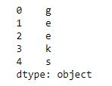
Series
A Pandas Series is a one-dimensional labeled array capable of holding data of any type (integer, string, float, python objects, etc.).
Creating a series from array:
To create a series from array, we have to import a numpy module and have to use array() function.
# import pandas as pd
import pandas as pd
# import numpy as np
import numpy as np
# simple array
data = np.array(['g','e','e','k','s'])
ser = pd.Series(data)
print(ser)

Slide 9
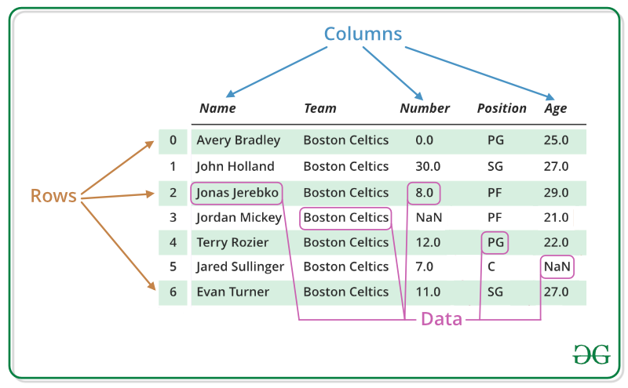
DataFrame
Pandas DataFrame is two-dimensional size-mutable, potentially heterogeneous tabular data structure with labeled axes (rows and columns).
We can perform basic operations on rows/columns like selecting, deleting, adding, and renaming.

Slide 10
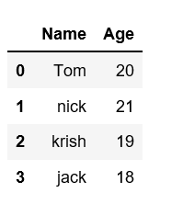
Creating DataFrame from dict of ndarray/lists:
import pandas as pd
# intialise data of lists.
data = {'Name':['Tom', 'nick', 'krish', 'jack'],
'Age':[20, 21, 19, 18]}
# Create DataFrame
df = pd.DataFrame(data)
# Print the output.
print(df)

Slide 11
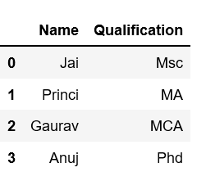
Column Selection
# Import pandas package
import pandas as pd
# Define a dictionary containing employee data
data = {'Name':['Jai', 'Princi', 'Gaurav', 'Anuj'],
'Age':[27, 24, 22, 32],
'Address':['Delhi', 'Kanpur', 'Allahabad', 'Kannauj'],
'Qualification':['Msc', 'MA', 'MCA', 'Phd']}
# Convert the dictionary into DataFrame
df = pd.DataFrame(data)
# select two columns
print(df[['Name', 'Qualification']])

Slide 12
Row Selection:
# importing pandas package
import pandas as pd
# making data frame from csv file
data = pd.read_csv("nba.csv", index_col ="Name")
# retrieving row by loc method
first = data.loc["Avery Bradley"]
second = data.loc["R.J. Hunter"]
print(first, "\n\n\n", second)
DataFrame.loc[ ] method is used to retrieve rows from Pandas DataFrame.
The loc() function is label based data selecting method which means that we have to pass the name of the row or column which we want to select.

Slide 13
Row Selection:
# retrieving rows by iloc method
row2 = data.iloc[3]
print(row2)
display(data.iloc[[0, 2, 4, 7]])
display(data.iloc[1: 5])
data.loc[(data.Number == 0), ['Team', 'College']]
The iloc() function is an indexed-based selecting method which means that we have to pass an integer index in the method to select a specific row/column.

Slide 14
Scikit-learn
Scikit-learn (Sklearn) is the most useful and robust library for machine learning in Python.
It implements a range of machine learning, pre-processing, cross-validation, and visualization algorithms.
The easiest way to install scikit-learn is using pip:
pip install -U scikit-learn
Scikit-learn comes loaded with a few example datasets like the iris and digits datasets for classification and the boston house prices dataset for regression.
from sklearn.datasets import load_iris
from sklearn import datasets
iris = datasets.load_iris()

Slide 15
How To Do Train Test Split Using Sklearn In Python
The train_test_split() method is used to split our data into train and test sets.
First, we need to divide our data into features (X) and labels (y).
The dataframe gets divided into X_train,X_test , y_train and y_test.
Syntax: sklearn.model_selection.train_test_split()
X_train, X_test, y_train, y_test = train_test_split(X, y, test_size=0.2, random_state=1234)
X_train, X_test, y_train, y_test = train_test_split(X, y, train_size=0.8, random_state=1234)

Slide 16
# import packages
import numpy as np
import pandas as pd
from sklearn.model_selection import train_test_split
# importing data
df = pd.read_csv('headbrain.csv')
# head of the data
print(df.head())
X= df['Head Size(cm^3)']
y=df['Brain Weight(grams)']
# using the train test split function
X_train, X_test,
y_train, y_test = train_test_split(X,y ,
random_state=104,
test_size=0.25,
shuffle=True)
# printing out train and test sets
print('X_train : ')
print(X_train.head())
print('')
print('X_test : ')
print(X_test.head())
print('')
print('y_train : ')
print(y_train.head())
print('')
print('y_test : ')
print(y_test.head())

Slide 17
TensorFlow
TensorFlow is a free and open-source software library for machine learning and artificial intelligence.
It was developed by the Google Brain team
TensorFlow Lite
Trained TensorFlow models can also be deployed on edge computing or mobile devices, such as iOS or Android systems.

Slide 18
Keras
Keras is a high-level neural network library that runs on top of TensorFlow.
PyTorch
PyTorch is a machine learning framework based on the Torch library.
Used for applications such as computer vision and natural language processing.

Slide 19
Matplotlib
Matplotlib is an amazing visualization library in Python for 2D plots of arrays.
Matplotlib is a multi-platform data visualization library built on NumPy arrays.
You need to run this command to install Matplotlib.
python -m pip install -U matplotlib
Importing Matplotlib
import matplotlib

Slide 20
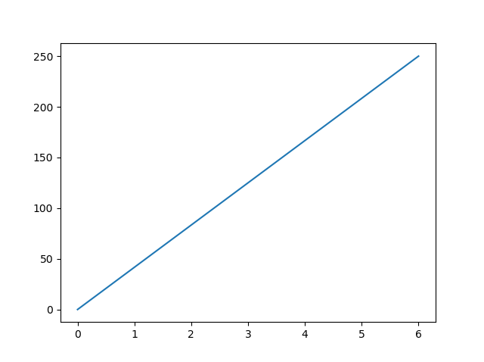
Matplotlib Pyplot
Draw a line in a diagram from position (0,0) to position (6,250):
import matplotlib.pyplot as plt
import numpy as np
xpoints = np.array([0, 6])
ypoints = np.array([0, 250])
plt.plot(xpoints, ypoints)
plt.show()

Slide 21
Thank You

